Slide 1
Logistic Regression and Naive Bayes Classifier

Slide 2
Learning Objectives
Introduction to Logistic Regression
Logit function in Logistic Regression
Probability Examples
Confusion Matrix
Hands on exercise on Logistic Regression
Introduction to Naïve Bayes Classifier
Naïve Bayes classifier in 2 dimension.
Bayes theorem
Case study on Logistic Regression
Case Study on Naive Bayes Classifier

Slide 3
Introduction to Logistic Regression
In statistics, the logistic model is a statistical model that is usually taken to apply to a binary dependent variable.
In regression analysis, logistic regression or logit regression is estimating the parameters of a logistic model.
In Logistic Regression, the dependent variable is binary rather than continuous and it can also be applied to ordered categories (ordinal data).

Slide 4
The term “Odds”
Popular in horse races, sports, gambling, epidemiology,
Instead of talking about the probability of winning or contacting a disease, people talk about the odds of winning or contacting a disease
How are these two different?
Additional content: Not part of the video but will be useful for getting an industry perspective

Slide 5


Logit function in Logistic Regression
In logistic regression, the dependent variable is a logit, which is the natural log of the odds, that is,
Additional content: Not part of the video but will be useful for getting an industry perspective

Slide 6
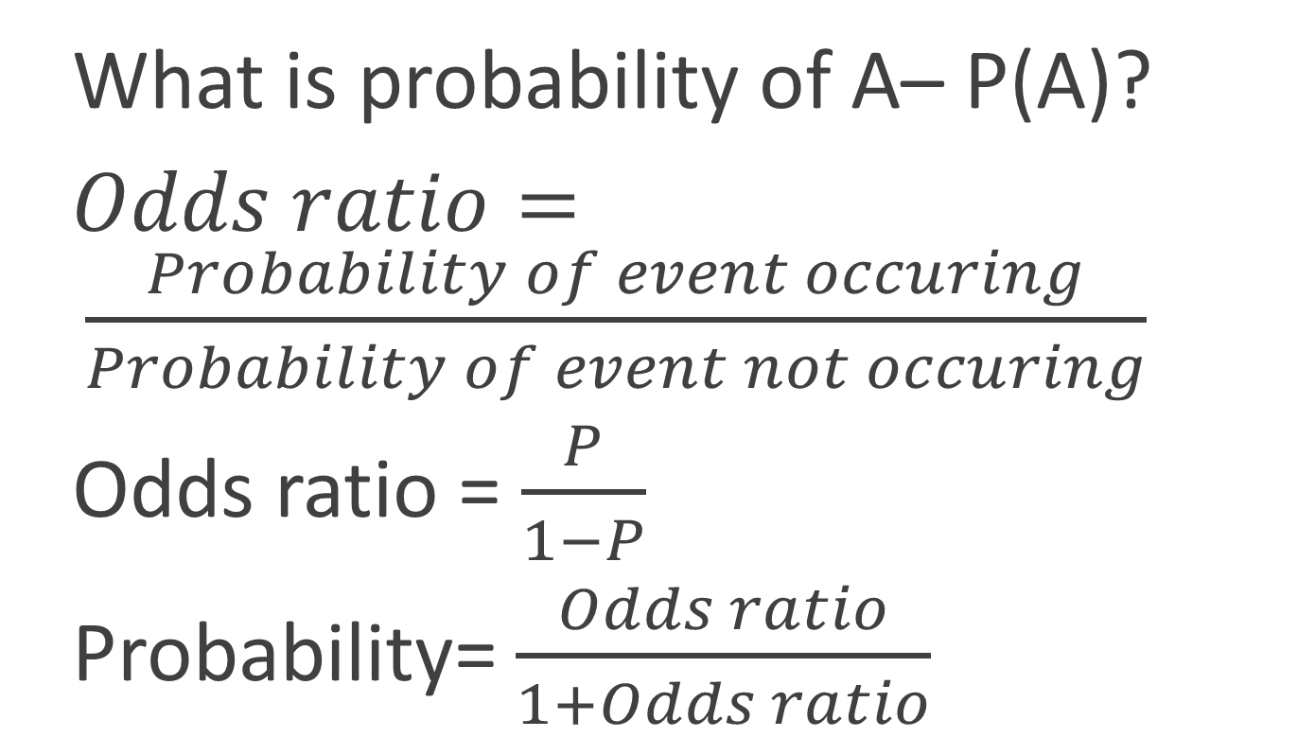
Odds vs Probability
What is probability of A– P(A)?
$Odds ratio= \frac{Probability of event occuring}{Probability of event not occuring}$
Odds ratio = $\frac{P}{1−P}$
Probability= $\frac{Odds ratio}{1+Odds ratio}$
Additional content: Not part of the video but will be useful for getting an industry perspective

Slide 7
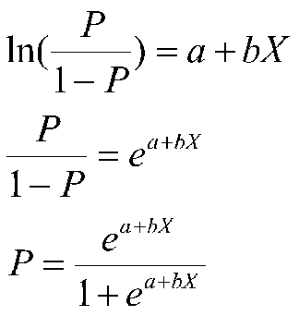
Math behind Logistic Regression
So a logit is a log of odds and odds are a function of P, the probability of a 1. In logistic regression, we find
logit(P) = a + bX,

Slide 8

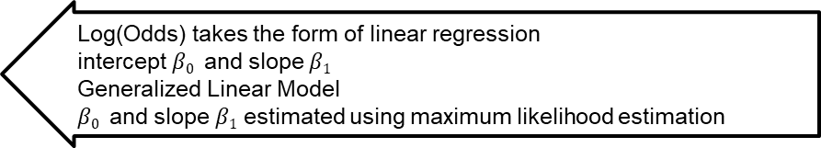
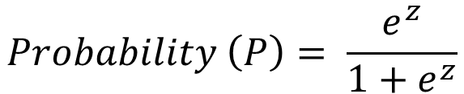
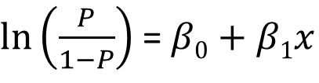
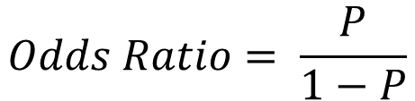
Math behind Logistic Regression
Predict likelihood or probability
Predicted value - >0 and <1
Use of sigmoid function to achieve this
$$Probability \left(P\right)= \frac{e^{z}}{1+e^{z}}$$
$$z= β0+β1x$$
$$Odds Ratio= \frac{P}{1−P}$$
Substituting for P, $Odds Ratio= \frac{P}{1−P}= e^{z}= e^{(β0+β1x)}$
Log(Odds) takes the form of linear regression
intercept $β0$ and slope $β1$
Generalized Linear Model
$β0$ and slope $β1$ estimated using maximum likelihood estimation
$ln⁡\left(\frac{P}{1−P}\right)$ = $β0+β1x$

Slide 9
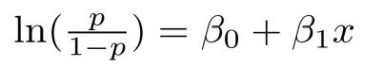
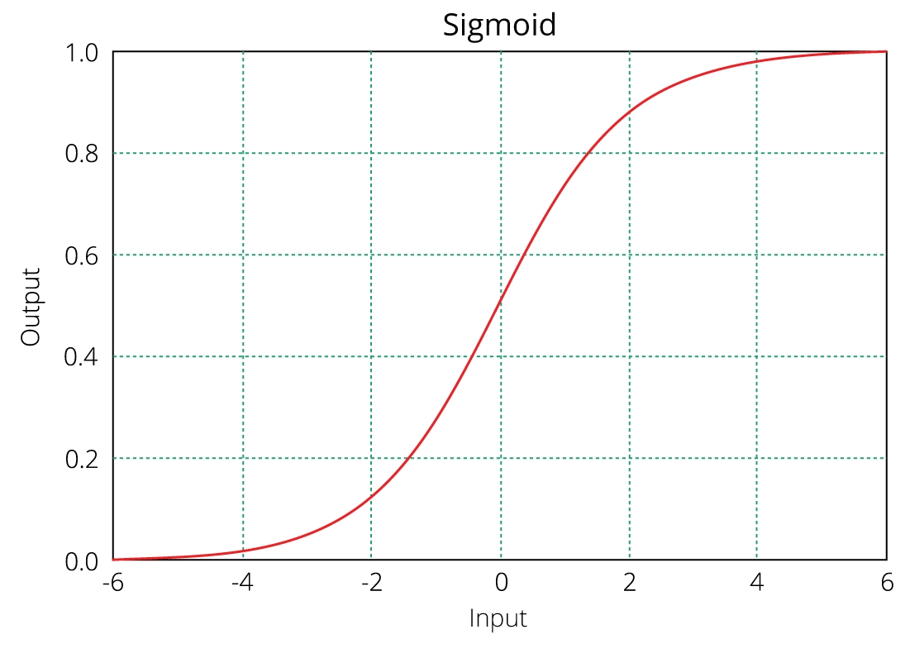
Equation of logistic regression
log - odds or odds ratio or logit function and is the link function for Logistic Regression
Regression intercept & coefficient
This link function follows a sigmoid function which limits its range of probabilities between 0 and 1.

Slide 10
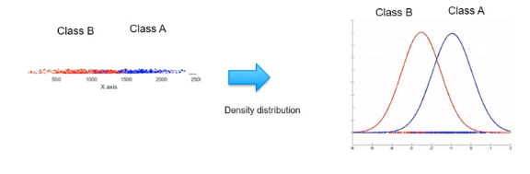
Probability Examples
Given the value of predictor (variable x), the model estimates the probability that the new data point belongs to a given class “A”. Probability values can range between 0 and 1.

Slide 11
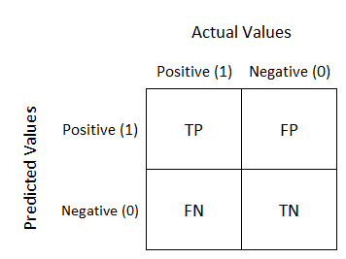
Confusion Matrix
Well, it is a performance measurement for machine learning classification problem where output can be two or more classes. It is a table with 4 different combinations of predicted and actual values.

Slide 12
Confusion matrix
 |  | Predicted
 |  | 0 | 1
Observed | 0 | TN | FP
 | 1 | FN | TP
Employees who will actually not attrite but predicted as will attrite
Employees who will actually attrite but predicted as will not attrite

Slide 13
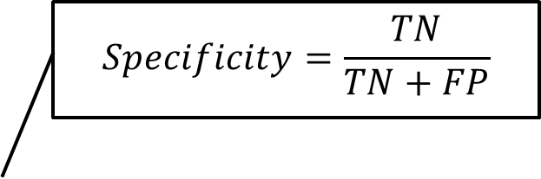
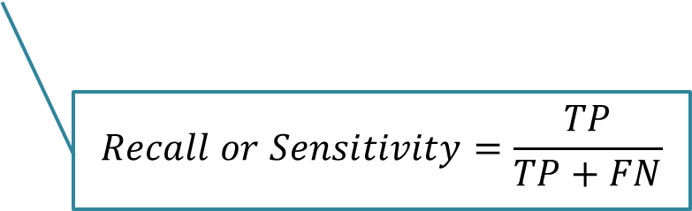
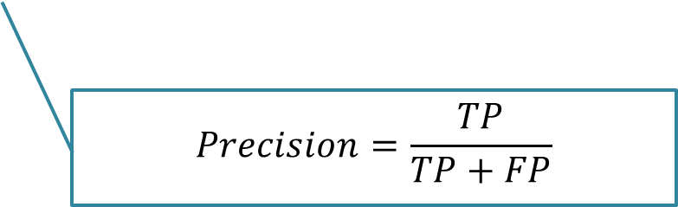
Confusion Matrix
 |  | Predicted
 |  | 0 | 1
Observed | 0 | TN | FP
 | 1 | FN | TP
$$Specificity=\frac{TN}{TN+FP}$$
$$Precision=\frac{TP}{TP+FP}$$
$$Recall or Sensitivity=\frac{TP}{TP+FN}$$

Slide 14
Why accuracy is not a good model performance measure?
Churn rate – 8%
Model predicts that no one churns
Accuracy – 92%
# Total customers – 100 # of customers who churn - 8
Misses out critical customers who churn

Slide 15
Hands on exercise on Logistic Regression
The dataset used here is pima-indians-diabetes.csv (https://archive.ics.uci.edu/ml/machine-learning-databases/pima-indians-diabetes/pima-indians-diabetes.data)
Some important functions:
1. Importing Libraries
import pandas as pd
import seaborn as sns
import numpy as np
2. Create a python list of column names called "names
colnames = ['preg', 'plas', 'pres', 'skin', 'test', 'mass', 'pedi', 'age', 'class']

Slide 16
Hands on exercise on Logistic Regression
3. Let us check whether any of the columns has any value other than numeric
pima_df[~pima_df.applymap(np.isreal).all(1)]
4. Lets analysze the distribution of the various attributes
pima_df.describe().transpose()
5. Let us look at the target column which is 'class' to understand how the data is distributed amongst the various values
pima_df.groupby(["class"]).count()

Slide 17
Hands on exercise on Logistic Regression
6. Pair plot using sns
sns.pairplot(pima_df)
7. test_size = 0.30 # taking 70:30 training and test set
seed =1 # Random number seeding for repeatability of the code
X_train, X_test, y_train, y_test = train_test_split(X, y, test_size=test_size, random_state=seed)
8. Fit the model
model = LogisticRegression()
model.fit(X_train, y_train)
y_predict = model.predict(X_test)
model_score = model.score(X_test, y_test)
print(model_score)

Slide 18
Introduction to Naïve Bayes Classifier
Naïve Bayes classifiers are probabilistic models based on Baye’s theorem.
It is called Naïve due to the assumption that the features in the dataset are mutually independent.
Idea is to factor all available evidence in form of predictors into the Naïve Bayes rule to obtain more accurate probability for class prediction.

Slide 19
NAIVE BAYES CLASSIFIER
Hundreds of thousands of data points and quite a few variables in your training data set - ‘Naive Bayes‘, can be extremely fast relative to other classification algorithms.
It works on Bayes theorem of probability to predict the class of unknown data set.
It is not a single algorithm but a family of algorithms where all of them share a common principle, i.e. every pair of features being classified is independent of each other.

Slide 20
Joint vs conditional probability
Joint Probability
likelihood of two events occurring together and at the same point in time
P(X ∩ Y) or P(X and Y) or P(XY)
Conditional probability
likelihood of an event or outcome occurring based on the occurrence of a previous event or outcome
calculated by multiplying the probability of the preceding event by the updated probability of the succeeding, or conditional, event

Slide 21
What is the 'Bayes' Theorem'?
Bayes' theorem, named after 18th-century British mathematician Thomas Bayes, is a mathematical formula for determining conditional probability.
The theorem provides a way to revise existing predictions or theories given new or additional evidence.
In finance, Bayes' theorem can be used to rate the risk of lending money to potential borrowers.

Slide 22
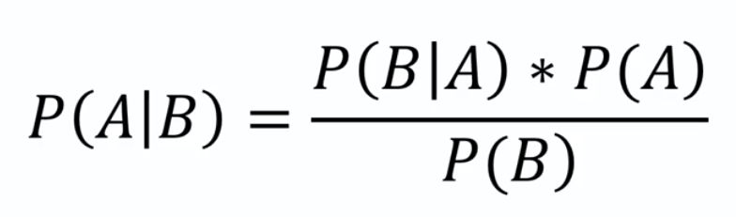
What is Bayes Theorem?

Slide 23

Bayes Probability Example
Mach1: 35 parts/hr
Mach2: 15 parts/hr
Out of all parts produced, 1% is defective
Out of all defective parts, 60% came from mach1 and 40% from mach2
What is the probability that a part produced by mach2 is defective?
P(Mach1) = 35/50 P(Mach2) = 15/50
P(Defect) = 1%
P(Mach1|Defect) =60%
P(Mach2|Defect) =40%
P(Defect|Mach2) = ???
P(Mach2|Defect) =40%
P(Mach2|Defect) * P(Defect)
P(Mach2)
P(Defect) = 1%
$$P(Defect|Mach2=\frac{P\left(Mach2 | Defect\right)∗P(Defect)}{P(Mach2)}$$
P(Mach2) = 15/50
0.4 * 0.01
15/50
0.0133

Slide 24


PRIOR & POSTERIOR PROBABILITY.....??
Winds
What did you read?
Winds (NOUN) or winds (VERB)?
This is posterior – with additional information from this picture you read it as ‘winds’ verb instead of the noun
This is the prior — in the absence of any data (i.e., context), you put higher probability on winds (noun) compared to winds (verb), because that is a more common usage.

Slide 25
Posterior probability
Prior Probability
This probability, wherein you condition on the data, is your posterior.
Posterior probability
the prior is what you believe about some quantity at particular point in time
posterior is your belief once additional information comes in
tells you the relative likelihood of different values of some quantity (a parameter) "in the absence of data".
tells you how you'd revise those beliefs "in the presence of data".

Slide 26
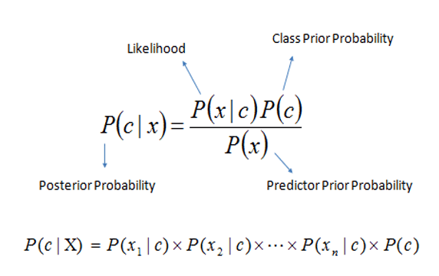
Bayes theorem in terms of the predictor x and class c of Y
P(c|x) is the posterior probability of class (c, target) given predictor (x, attributes).
P(c) is the prior probability of class.
P(x|c) is the likelihood which is the probability of predictor given class.
P(x) is the prior probability of predictor.

Slide 27
What is Naive Bayes algorithm?
Classification technique based on Bayes’ Theorem with an assumption of independence among predictors.
Naive Bayes model is easy to build and particularly useful for very large data sets. Along with simplicity, Naive Bayes is known to outperform even highly sophisticated classification methods.
Bayes theorem provides a way of calculating posterior probability P(c|x) from P(c), P(x) and P(x|c).

Slide 28
Why is it called Naïve Bayes?
Independence assumption of Bayes theorem – for example Age and Salary need to be independent.
In real life, this might not be the case
Naïve Bayes algorithm is naïve in that it makes this assumption in spite of this not being true

Slide 29
How does Naïve Bayes work?
Find all the other records with the same predictor profile (i.e., where the predictor values are the same).
Determine what classes the records belong to and which class is most prevalent.
Assign that class to the new record.

Slide 30
How the Naïve Bayes Algorithm works
temp | humidity | trek
sunny | high | NO
sunny | high | NO
overcast | high | YES
rainy | high | YES
rainy | normal | YES
rainy | normal | NO
overcast | normal | YES
sunny | high | NO
sunny | normal | YES
rainy | normal | YES
sunny | normal | YES
overcast | high | YES
overcast | normal | YES
sunny | high | YES
P(YES) | 10/14
P(NO) | 4/14
Temp | YES | NO | P(YES) | P(NO) | total
sunny | 3 | 3 | 3/10 | 3/4 | 6
overcast | 4 | 0 | 4/10 | 0 | 4
rainy | 3 | 1 | 3/10 | 1/4 | 4
Total | 10 | 4 |  |  | 14
humidity | YES | NO | P(YES) | P(NO) | total
high | 4 | 3 | 4/10 | 3/4 | 7
normal | 6 | 1 | 6/10 | 1/4 | 7
Total | 10 | 4 | 100% | 100% | 14
Should we trek or not – when temp is SUNNY and humidity is HIGH
P(sunny|YES) = 3/10 *
P(humidity = high|YES) = 4/10 *
P(trek=YES) = 10/14 =
0.085
P(sunny|NO) = 3/4 *
P(humidity = high|NO) = 3/4 *
P(trek=NO) = 4/14 =
0.16
P(temp=sunny) = 6/14 *
P(humidity = high)=7/14 =
0.214
0.397
0.747

Slide 31
Case study on Logistic Regression
Context:
Credit risk is nothing but the default in payment of any loan by the borrower. In Banking sector this is an important factor to be considered before approving the loan of an applicant.Dream Housing Finance company deals in all home loans. They have presence across all urban, semi urban and rural areas. Customer first apply for home loan after that company validates the customer eligibility for loan.
Company wants to automate the loan eligibility process (real time) based on customer detail provided while filling online application form.

Slide 32
Case study on Logistic Regression
Data Attributes:
Loan_ID Unique Loan ID
Gender Male/ Female
Married Applicant married (Y/N)
Dependents Number of dependents
Education Applicant Education (Graduate/ Undergraduate)
Self_Employed Self employed (Y/N)
ApplicantIncome Applicant income

Slide 33
Case study on Logistic Regression
8. CoapplicantIncome Coapplicant income
9. LoanAmount Loan amount in thousands
10. Loan_Amount_Term Term of loan in months
11. Credit_History credit history meets guidelines
12. Property_Area Urban/ Semi Urban/ Rural
13. Loan_Status Loan approved (Y/N)

Slide 34
Steps to follow
Import libraries
Get the data and find the heading
Drop the variables that are unique and are not used.
Perform “one hot encoding “ for all categorical variables.
Analyse the distribution of various attribute.
Look at the target column, to understand how the data is distributed amongst the various values.
Split the data into Train and Test set.
Fit the model and calculate Accuracy through Confusion Matrix.

Slide 35
Case Study on Naive Bayes Classifier
Objective:
To predict whether income exceeds 50K/yr based on census data.
Variable description:
Age: continuous
Workclass: Private, Self-emp-not-inc, Self-emp-inc, Federal-gov, Local-gov, State-gov, Without-pay, Never-worked.
Fnlwgt: continuous.
Education: Bachelors, Some-college, 11th, HS-grad, Prof-school, Assoc-acdm, Assoc-voc, 9th, 7th-8th, 12th, Masters, 1st-4th, 10th, Doctorate, 5th-6th, Preschool.
Education-num: continuous.
Marital-status: Married-civ-spouse, Divorced, Never-married, Separated, Widowed, Married-spouse-absent, Married-AF-spouse.

Slide 36
Case Study on Naive Bayes Classifier
Occupation: Tech-support, Craft-repair, Other-service, Sales, Exec-managerial, Prof-specialty, Handlers-cleaners, Machine-op-inspct, Adm-clerical, Farming-fishing, Transport-moving, Priv-house-serv, Protective-serv, Armed-Forces.
Relationship: Wife, Own-child, Husband, Not-in-family, Other-relative, Unmarried.
Race: White, Asian-Pac-Islander, Amer-Indian-Eskimo, Other, Black.
Sex: Female, Male.
Capital-gain: continuous.
Capital-loss: continuous.
Hours-per-week: continuous.
Native-country: United-States, Cambodia, England, Puerto-Rico, Canada, Germany, Outlying-US(Guam-USVI-etc), India, Japan, Greece, etc.

Slide 37
Steps to follow
Import the libraries.
Get the data.
Add headers to the dataframe
Handle missing data
Perform Data preprocessing by duplicating copy of the original dataframe.
Perform Hot encoding
Initialize the encoded categorical columns
Split the data into train and test
Implement Gaussian Naive Bayes
Calculate Accuracy

Slide 38


Questions?

